Slide 1
Supply Chain Risk Analysis
Team Harris
Adrian Eldridge, Gazi Naven, Peter Chen, Trevor Whitestone

Slide 2
Overview
Background / Problem Description
Data Description/Preparation
Exploratory Analysis
Methods
Binning
Decomp Models
Clustering
Results
Future Work

Slide 3
Background
Overview of Harris
Supply chain
Problem
Objectives

Slide 4
Problem Description
Harris Corporation: minimize risk of supply-chain disruptions
90% of supply-chain data created in last two years
Requires modern approach
Goal: group Harris’s suppliers by risk
Identify indicators and characteristics that flag a supplier as risky
Notes:
As a manufacturing company, Harris Corporation is heavily concerned with minimizing the risk
of supply chain disruptions. Given that 90% of Harris’s supply chain data has been created in
the last two years, the task requires a modern approach. For this project, we are focused on
grouping Harris’s supplier as low, medium, or high risk based. Concurrently, we must identify
indicators and characteristics that would flag a supplier as risky. Along with additional
exploratory analysis, these findings will allow Harris to have an enhanced resilient supply chain.
Currently, we are still in the exploratory phase but are also beginning preliminary modeling with
clusters. Our strategy will be to develop a risk score based on a linear combination of available
attributes. We will then compare these scores to supplier clusters we develop to determine
which clusters are riskiest.

Slide 5
Data Preparation
Datasets
Cleaning/Feature Engineering

Slide 6
Initial Datasets
Received following three datasets from Harris:
Expo archive
113194 rows x 24 features
Logistic information about transactions (order data, delivery data, etc.)
Purchasing Tool
135181 rows x 34 features
Information about the transactions (cost per part, quantity ordered, purchase lead time, etc.)
Scorecard
11425 rows x 8 features
Harris designated ratings of a supplier for a particular time period

Slide 7
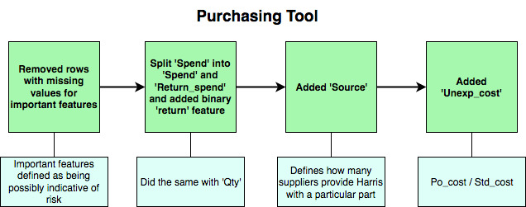
Cleaning/Feature Engineering

Slide 8
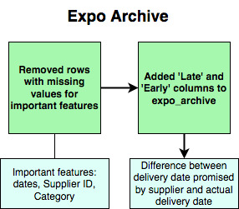
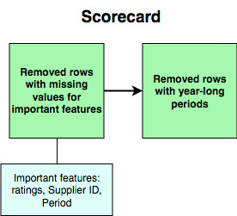
Cleaning/Feature Engineering

Slide 9
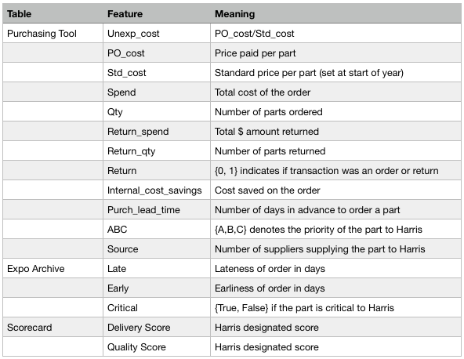
Features

Slide 10
Exploratory Analysis
Observations
Distributions

Slide 11
Observations
Delivery Status | On Time | Late | Early
Count | 4033 | 586 | 67771
Percent | 5.6% | 0.8% | 93.6%

Slide 12
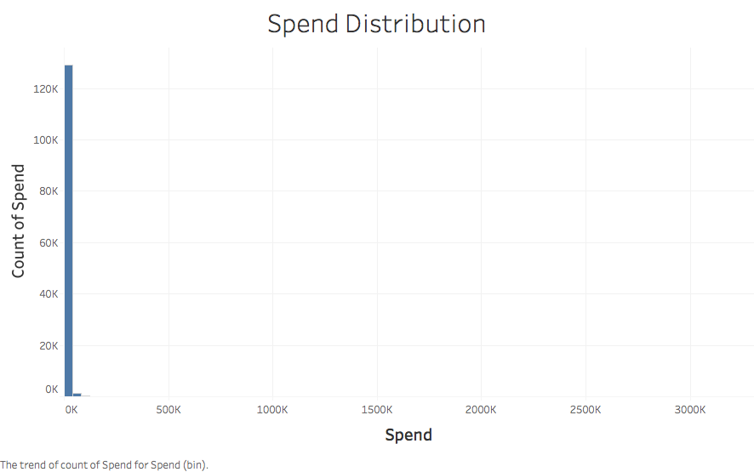
Distribution of Spend

Slide 13
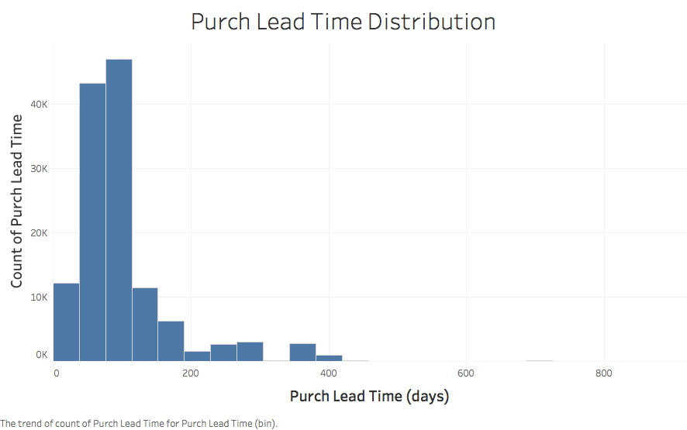
Distribution of Purch Lead Time

Slide 14
Methods
Data
Dimensionality Reduction
Clustering

Slide 15
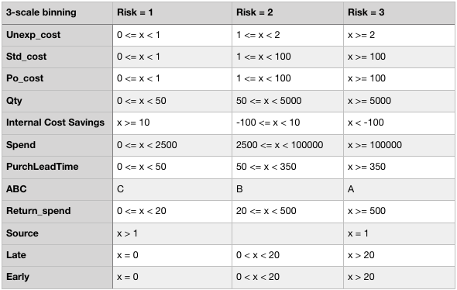
Binning
Three binning schemes:
1-5 Scale
1-3 Scale
1-2 Scale
1-3 Scale Bins -->

Slide 16
Binning
Reduces skewness of the data
Introduces our understanding of risk to the data
Method of normalization

Slide 17
Binning
Three binning schemes:
1-5 Scale
1-3 Scale
1-2 Scale
1-3 Scale Bins -->

Slide 18
Binning
Three binning schemes:
1-5 Scale
1-3 Scale
1-2 Scale
1-3 Scale Bins -->

Slide 19
Binning
Three binning schemes:
1-5 Scale
1-3 Scale
1-2 Scale
1-3 Scale Bins -->

Slide 20
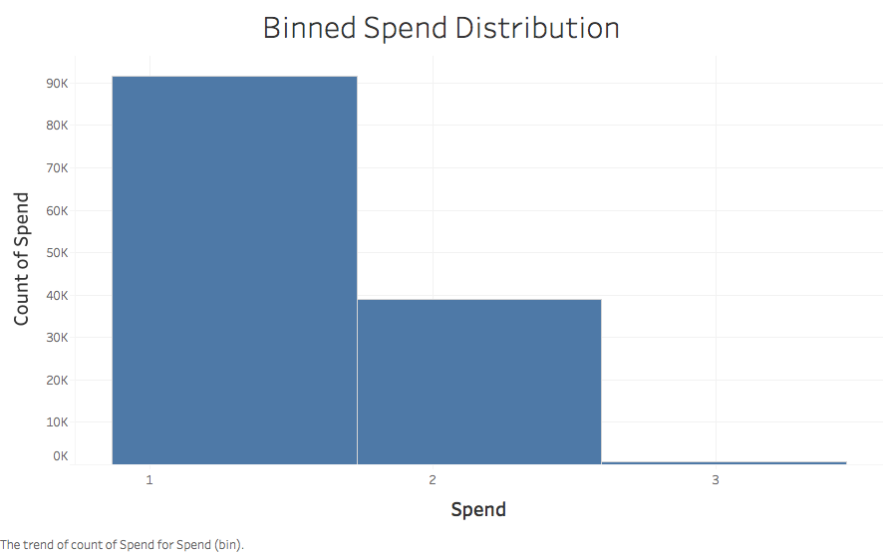
Distribution of Binned Spend

Slide 21
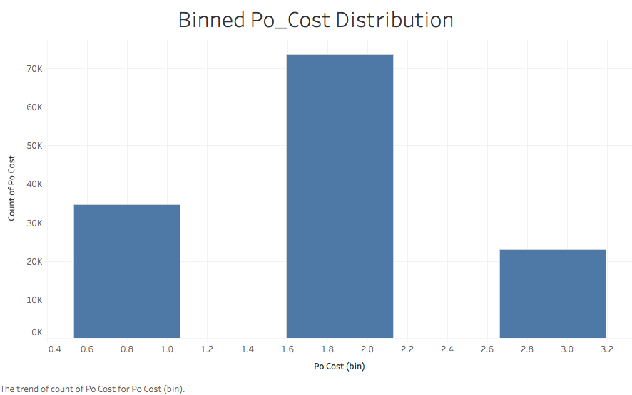
Distribution of Binned Po_Cost

Slide 22
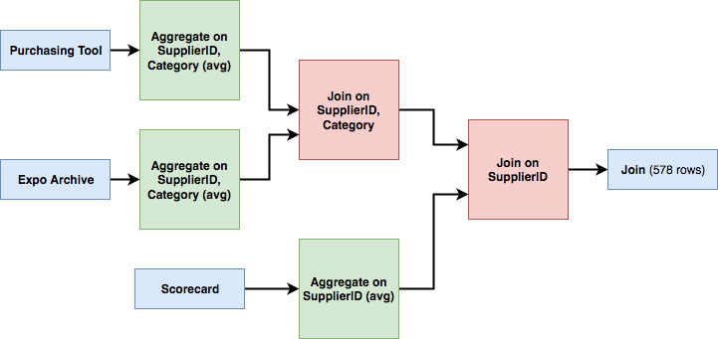
Joining

Slide 23
Methods: Dimensionality and Noise Reduction
Problems with number of features
Problems with noise

Slide 24
Goals: Challenges:
Define and predict risk
Find and handle difficult qualities of the data
No inherent risk measure
Black box metrics
Ex. Supplier Risk Score, ABC Ranking
Internal measures that we do not have access to

Slide 25
Goals: Challenges:
Define and predict risk
Find and handle difficult qualities of the data
No inherent risk measure
Black box metrics
Ex. Supplier Risk Score, ABC Ranking
Internal measures that we do not have access to
Categorial metrics
Difficult to assign any risk value independently
Uncertain relation to other variables

Slide 26
Goals: Challenges:
Define and predict risk
Find and handle difficult qualities of the data
No inherent risk measure
Black box metrics
Ex. Supplier Risk Score, ABC Ranking
Internal measures that we do not have access to
Categorial metrics
Difficult to assign any risk value independently
Uncertain relation to other variables
Too many features
30 features in Purchasing Tool
20 in Expo Archive
2 in Scorecard

Slide 27
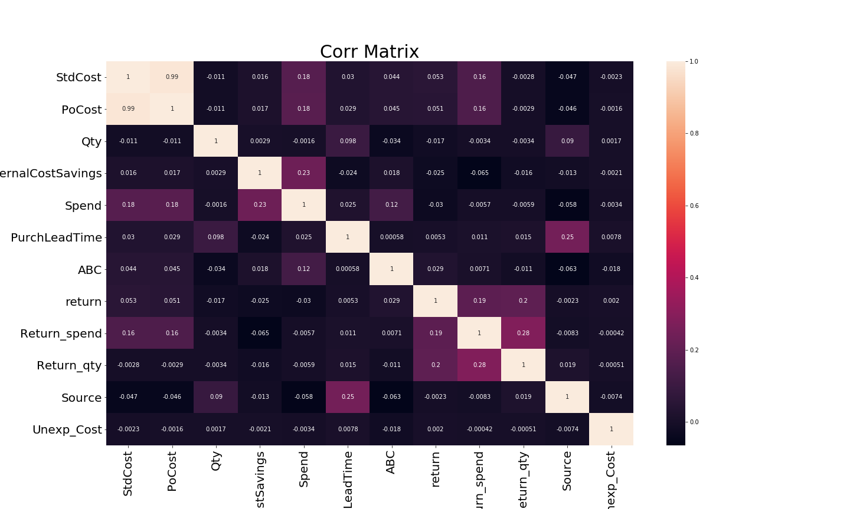
Solutions
Separate data with known relationships

Slide 28
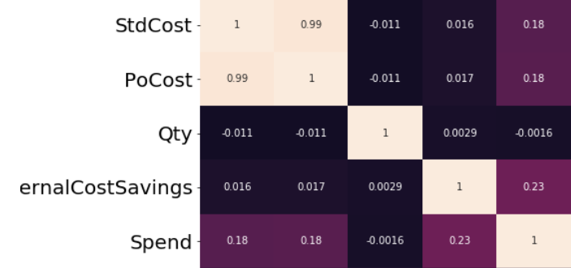
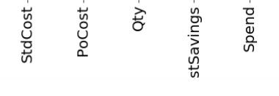
Solutions
Reduce StdCost and PoCost to Unexp_cost:
Unexp_cost = StdCost/PoCost
This is because we know for sure that PoCost * Qty = Spend
Notes:
This allows us to directly separate the relationships between the features and reduce their number

Slide 29
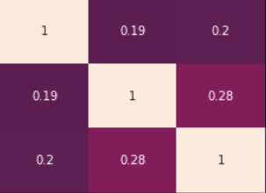
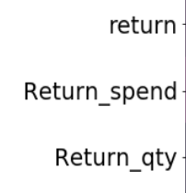
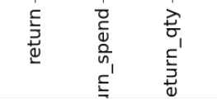
Solutions
Eliminate return, Return_qty
Return qty is unpredictable and indirect measure of risk
Return is captured by Return spend
Keep Return_spend
Return_spend is robust when aggregating
Notes:
Similarly, for return, return_spend, and return_qty, we can manually separate them because we know the relationship.
We made the decision to throw out return_qty because it is a less direct, more unpredictable measure of risk than spend.
Similarly for return because return_spend captures more and is less affected by aggregation

Slide 30
Solution: Risk Sum
We binned in such a way that analyzed each feature based on each risk
We can calculate a “risk sum” feature for each (vendor, category)
Ex:
[Qty = 2, Spend = 1, Critical = 1]
Risk Sum = 2 + 1 + 1 = 4

Slide 31
Decomposition:
3 Models
PCA
Varimax
Factor Analysis
Feature elimination
Noise reduction
Minimal Representation of the data

Slide 32
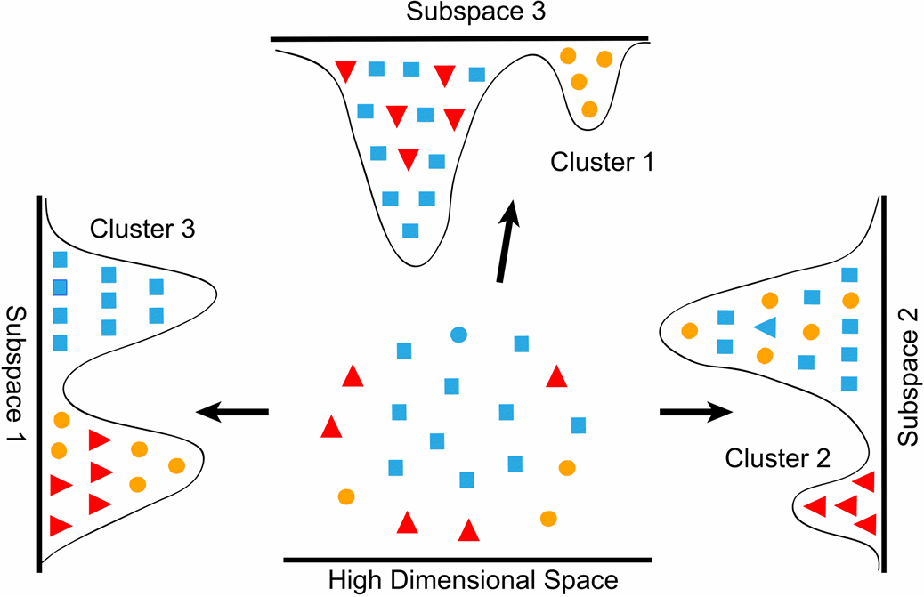
Decomposition(continued)
Example:
Component 2 can differentiate red from the rest

Slide 33
Decomposition(continued)
Example:
Component 2 can differentiate red from the rest
Component 3 can differentiate orange from the rest

Slide 34
Decomposition(continued)
Example:
Component 2 can differentiate red from the rest
Component 3 can differentiate orange from the rest
Component 2+3 can categorize all details of the space.

Slide 35
Decomposition(continued)
Example:
Component 2 can differentiate red from the rest
Component 3 can differentiate orange from the rest
Component 2+3 can categorize all details of the space.
True dimensionality of this data was 2

Slide 36
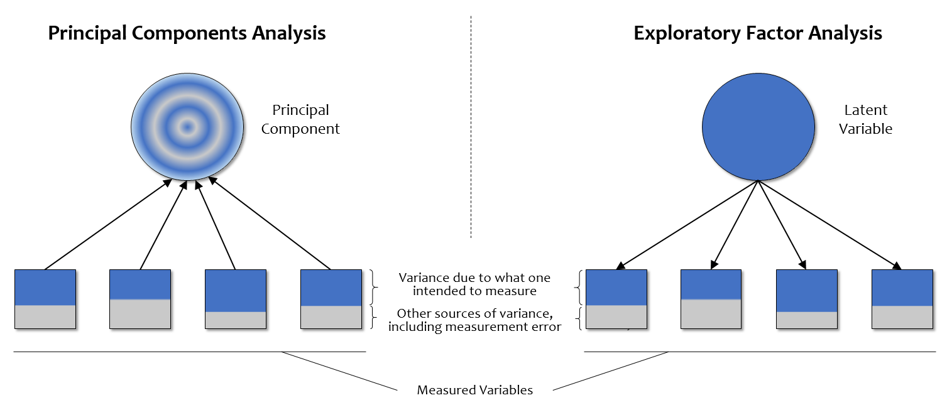
PCA and FA

Slide 37
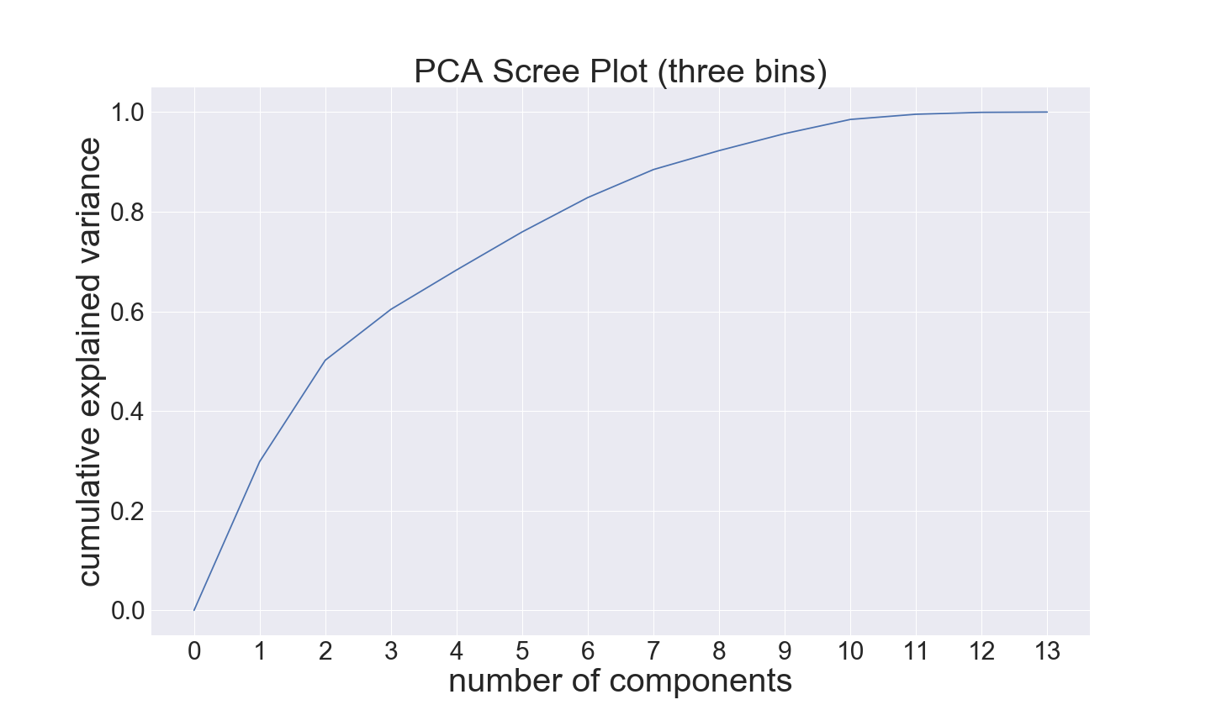
PCA as dimension reduction
PCA Generates a number of components that together explain the observed differences in the data.
Here, of the 12 components, only 6 are needed to explain 90% of the variance in the data.

Slide 38
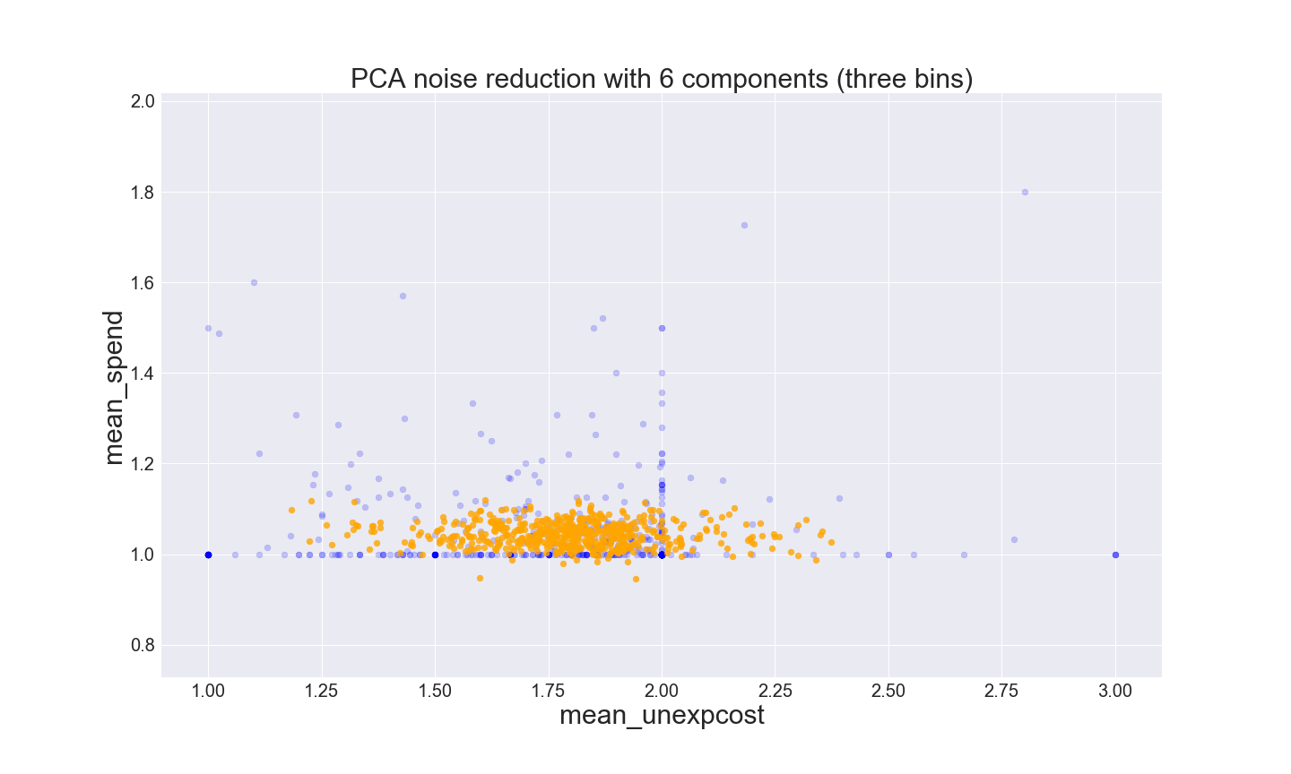
PCA as noise reduction
We selected 6 components to explain 90% of the data
Here we see that extreme variables are reduced
This is a form of noise reduction to only keep the most descriptive variables

Slide 39
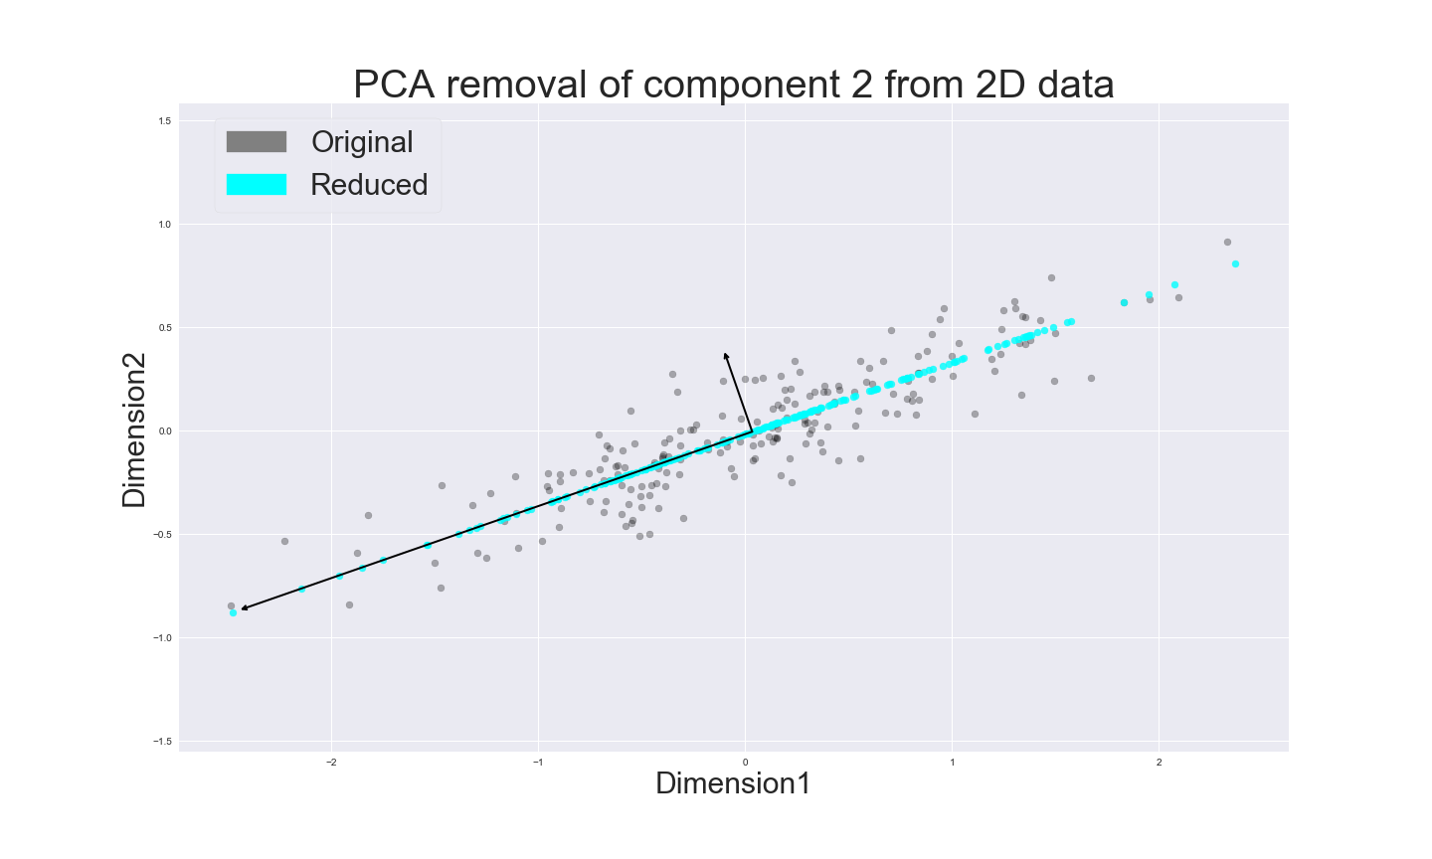
What happens to views of less important components that are pruned/not considered

Slide 40
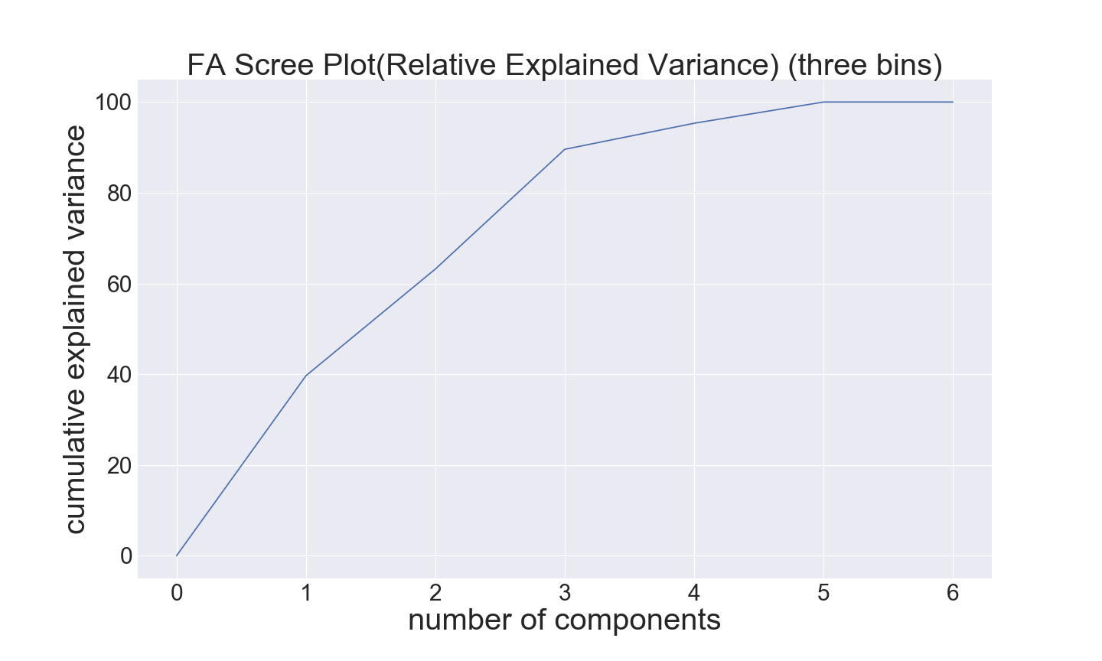
Factor Analysis
Factor analysis tends to be much more aggressive with noise.
The three first components make up 90% of the relative explained data.
This method is good for data with hidden influences.

Slide 41
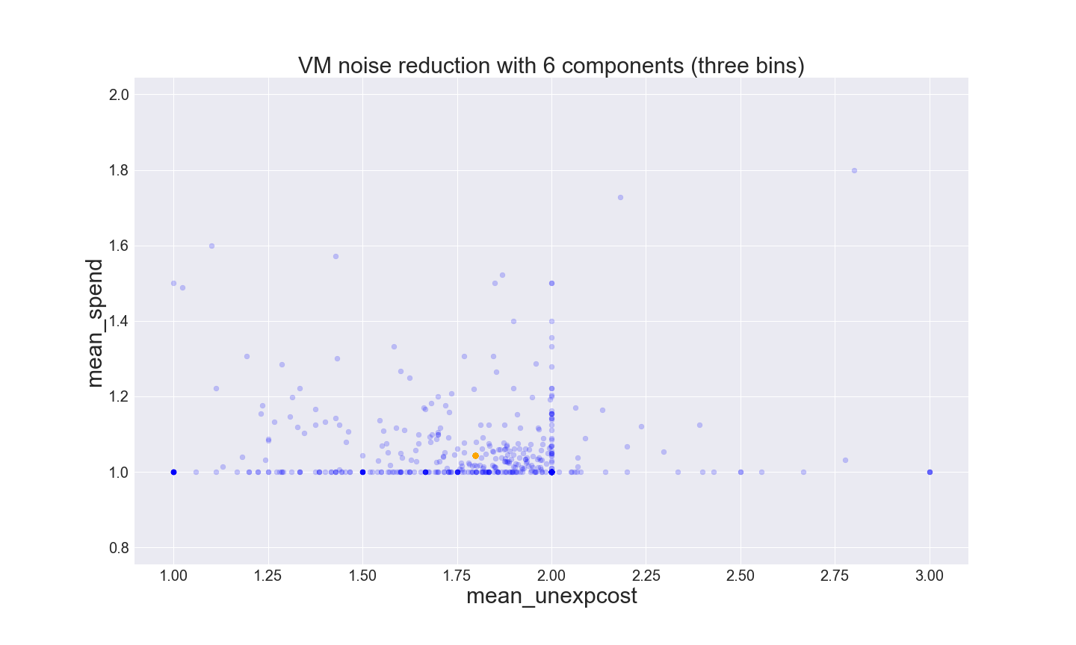
PCA + Varimax
Varimax readjusts the principal components to match at most one feature
Hopefully this makes the results more explainable. This will zero out some variables as seen here.

Slide 42
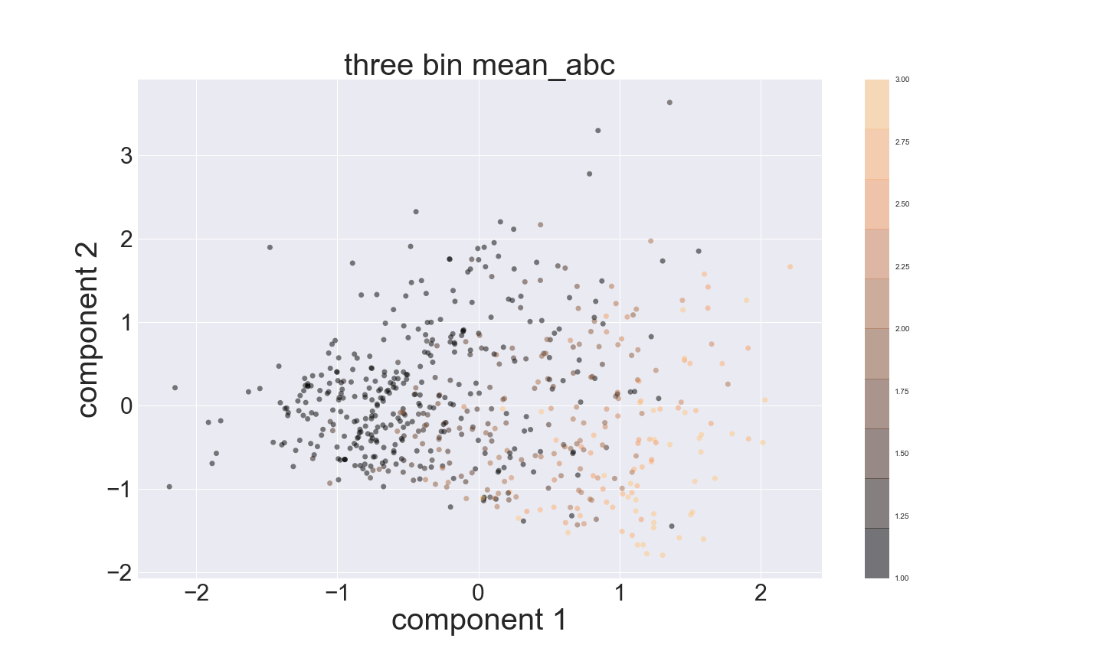

Slide 43
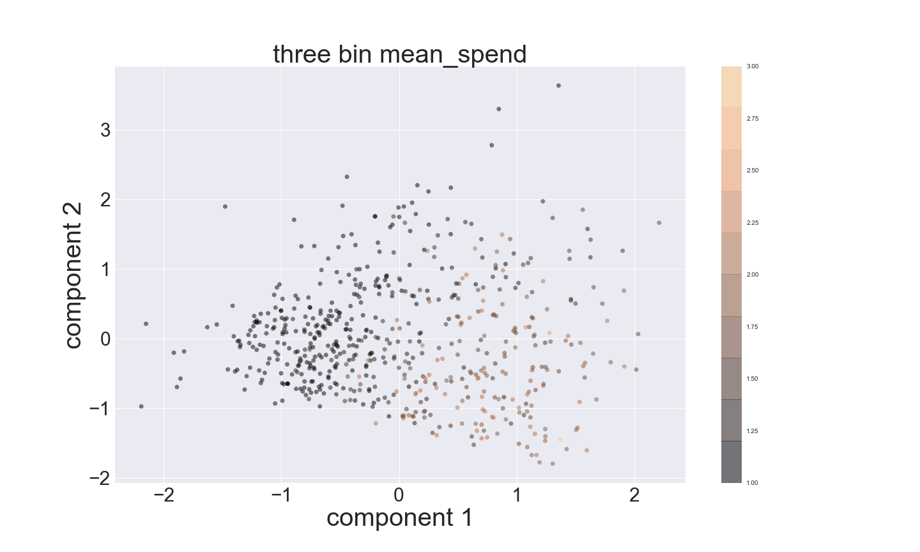

Slide 44
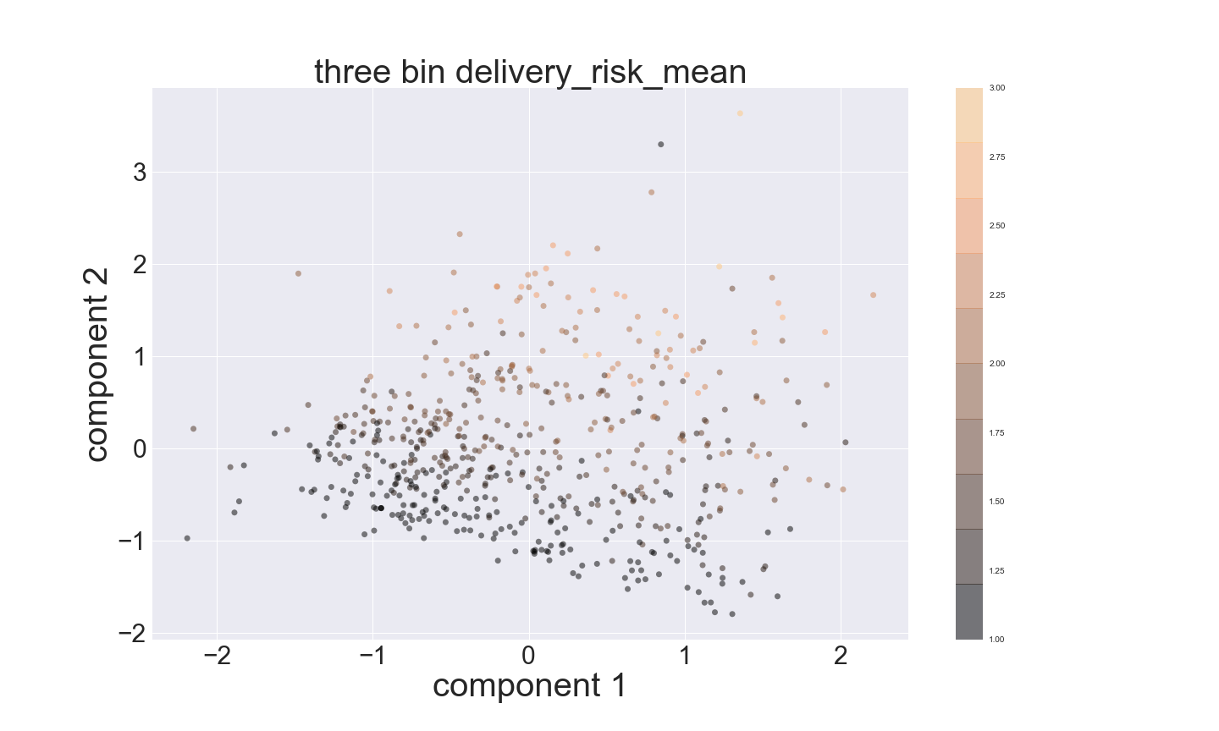

Slide 45
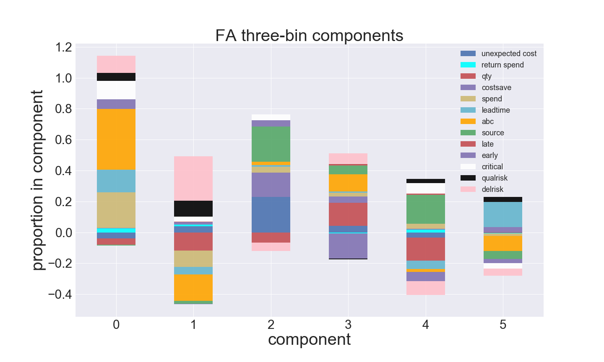

Slide 46
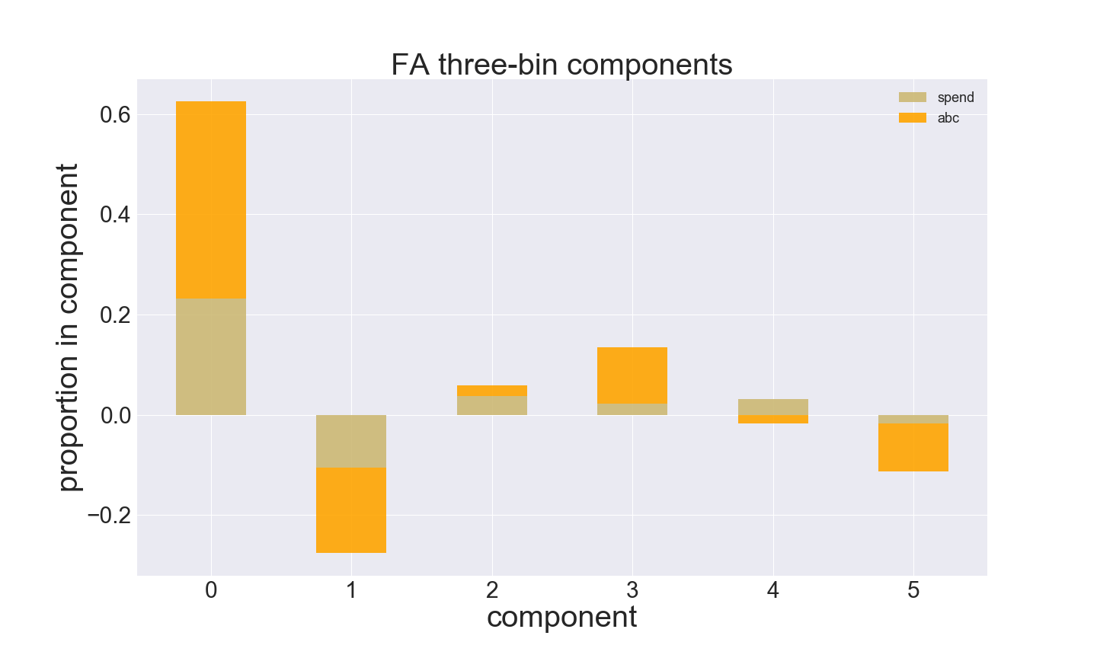
Spend and abc being consistently related confirms that abc includes spend in its rankings.

Slide 47
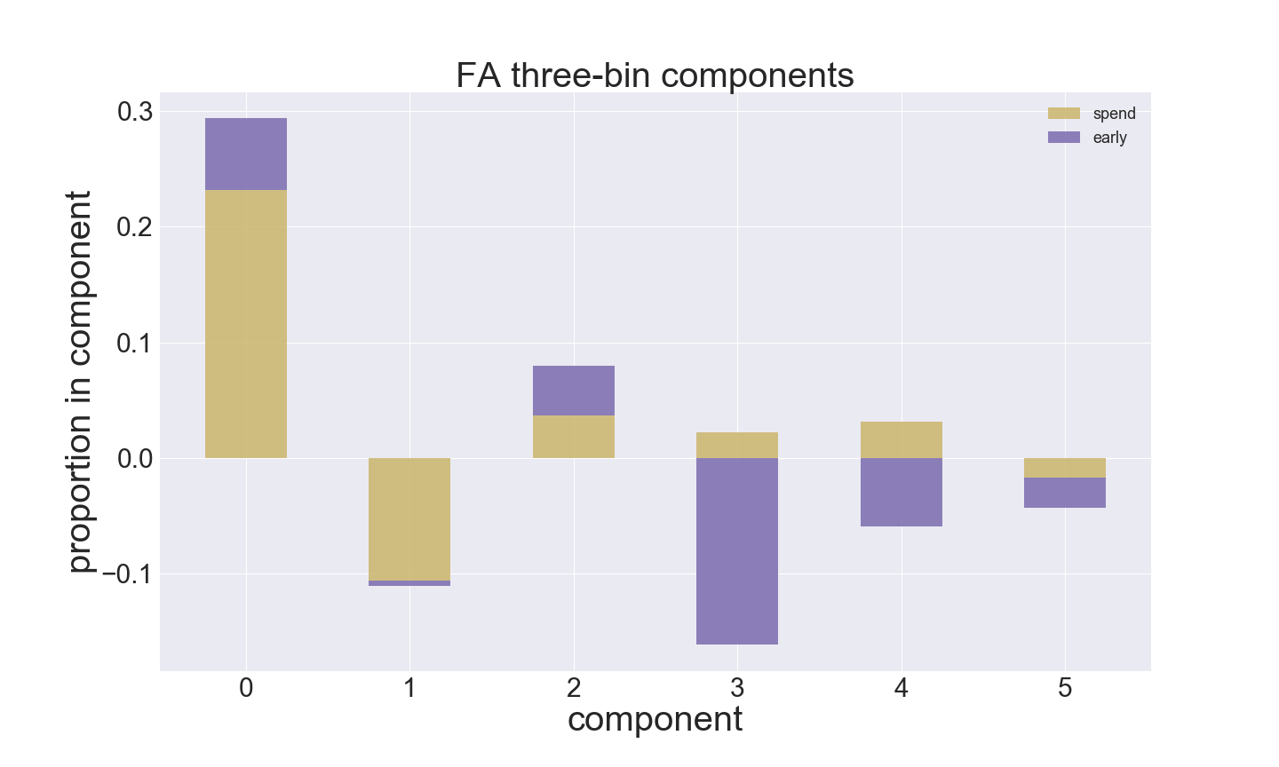
Spend and Early show a consistent relationship in the first three components (~95% of variance)

Slide 48
Methods: Clustering

Slide 49
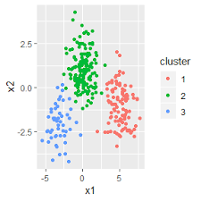

Clustering
Component 1
Component 3
Component 2
Component 4
Component 5
Component 6
k-Means Clustering
Factor Analysis Features Used
Optimal number of clusters

Slide 50
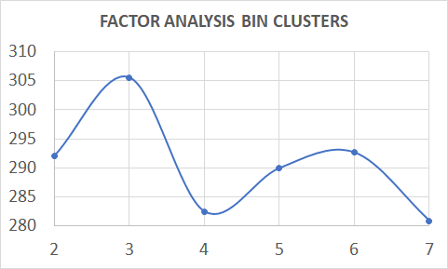
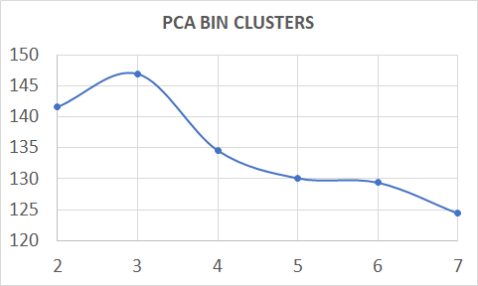
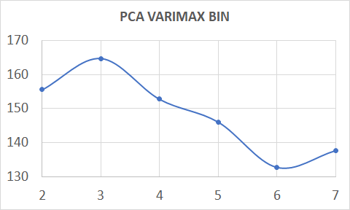
Clustering: Optimal Clusters
Risk Level Bins -> 1 & 2
Data -> Factor Analysis Dimensions, PCA Dimensions, PCA Varimax Dimensions
CH Score
Number of Clusters

Slide 51
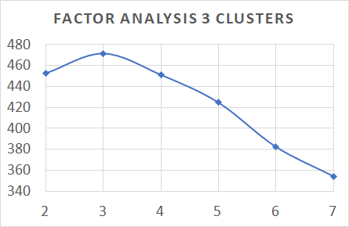
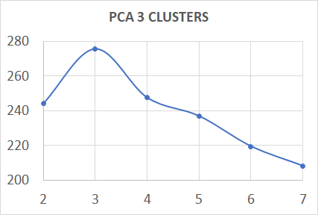
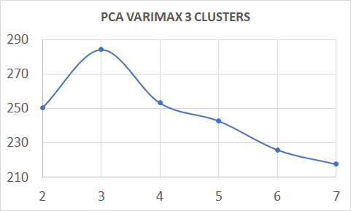
Clustering: Optimal Clusters
Risk Level Bins -> 1 - 3
Data -> Factor Analysis Dimensions, PCA Dimensions, PCA Varimax Dimensions
CH Score
Number of Clusters

Slide 52
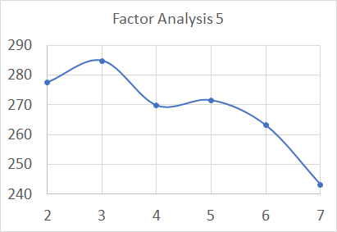
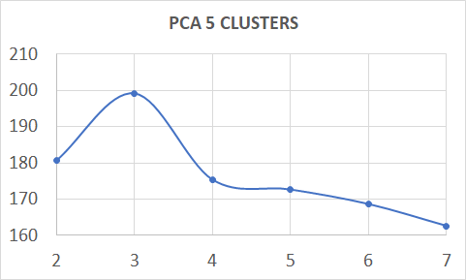
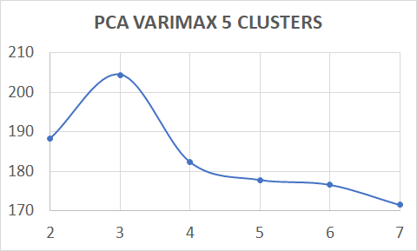
Clustering: Optimal Clusters
Risk Level Bins -> 1 - 5
Data -> Factor Analysis Dimensions, PCA Dimensions, PCA Varimax Dimensions
CH Score
Number of Clusters

Slide 53
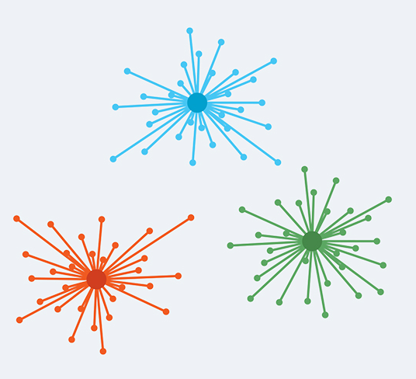
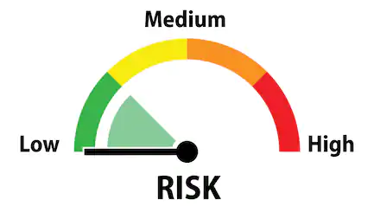
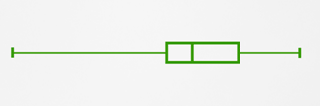
Find What do These Clusters Mean
Median Comparison of Raw Features in Clusters
Risk Profiles of Cluster
Risk Sum and Clusters
Notes:
Risk Profile
-Cluster Sepearation
-pvalues

Slide 54
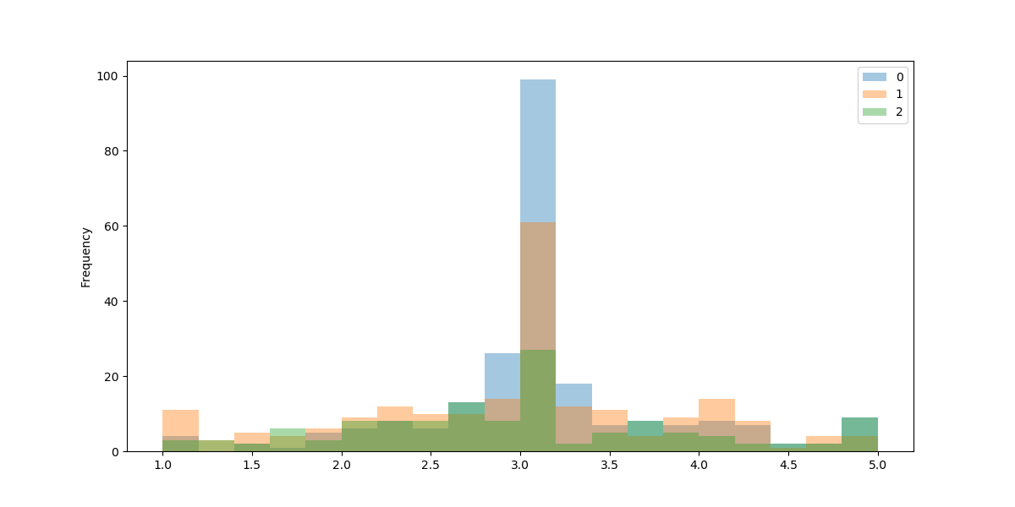
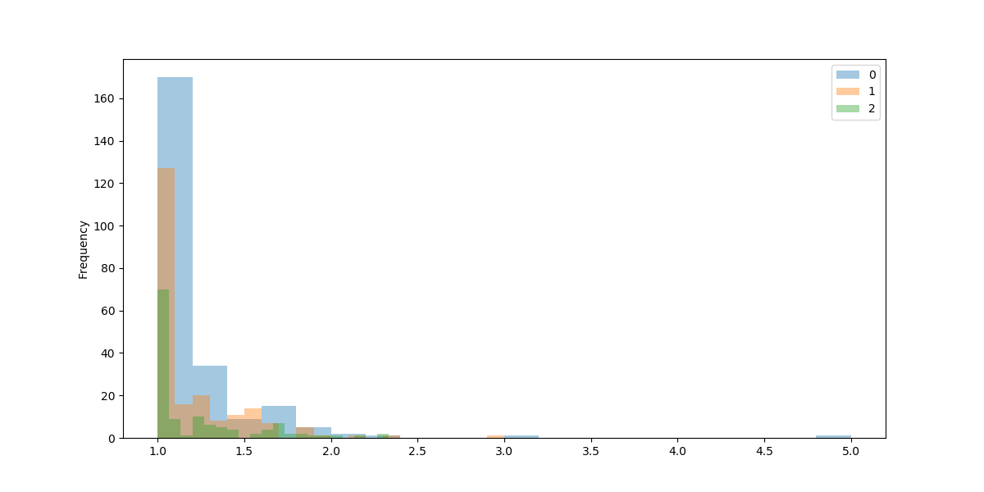
Statistical Testing
Kruskal Wallis test (Non-Parametric Distribution)
ANOVA (Normal Distribution)

Slide 55
Results
Cluster Analysis

Slide 56
Model Elimination
Models with Binary Risk Bins
Reducing Signals a lot
Standard PCA models
Creates Unexplainable Features

Slide 57
Cluster Analysis: Risk Profile
Model | Cluster 0 | P-value (Seperation) | Cluster 1 | P-value (Seperation) | Cluster 2 | P-value (Seperation)
PCA 3 varimax | Mean source (low feature) | 9.77E-94 (good on low risk) | Mean spend | 2.75E-22 (medium) | Mean Unexpected cost | 0.0027 (good)
 |  |  | Mean abc | 4.82E-64 (Very good)
FA 3 | Mean spend | 3.58E-38 (Very good) | Mean qty | 0.0117 (medium) | Mean Unexpected cost | 2.05E-08 (good)
 | Mean abc | 5.84E-82 (Very good) |  |  | Mean source | 2.16E-68 (good)
PCA 5 varimax | Mean source | 1.26E-78 (good) | Mean std cost | 6.26E-13 (medium) | Unexpected cost | 0.000227 (medium)
 |  |  | Mean spend | 1.54E-31 (medium) | Mean qty | 0.032 (Not good)
 |  |  | Mean abc | 7.21E-77 (Very good)
FA 5 | Mean source | 3.89E-83 (good) | Mean Unexpected cost | 0.000113 (medium) | Mean std cost | 1.62E-17 (medium)
 |  |  | Mean qty | 0.00023 (Not good) | Mean spend | 1.63E-37 (good)
 |  |  |  |  | Mean abc | 5.52E-16 (Very good)

Slide 58
Cluster Analysis: Risk Profile
Model | Cluster 0 | P-value (Seperation) | Cluster 1 | P-value (Seperation) | Cluster 2 | P-value (Seperation)
PCA 3 varimax | Mean source (low feature) | 9.77E-94 (good on low risk) | Mean spend | 2.75E-22 (medium) | Mean Unexpected cost | 0.0027 (good)
 |  |  | Mean abc | 4.82E-64 (Very good)
FA 3 | Mean spend | 3.58E-38 (Very good) | Mean qty | 0.0117 (medium) | Mean Unexpected cost | 2.05E-08 (good)
 | Mean abc | 5.84E-82 (Very good) |  |  | Mean source | 2.16E-68 (good)
PCA 5 varimax | Mean source | 1.26E-78 (good) | Mean std cost | 6.26E-13 (medium) | Unexpected cost | 0.000227 (medium)
 |  |  | Mean spend | 1.54E-31 (medium) | Mean qty | 0.032 (Not good)
 |  |  | Mean abc | 7.21E-77 (Very good)
FA 5 | Mean source | 3.89E-83 (good) | Mean Unexpected cost | 0.000113 (medium) | Mean std cost | 1.62E-17 (medium)
 |  |  | Mean qty | 0.00023 (Not good) | Mean spend | 1.63E-37 (good)
 |  |  |  |  | Mean abc | 5.52E-16 (Very good)

Slide 59
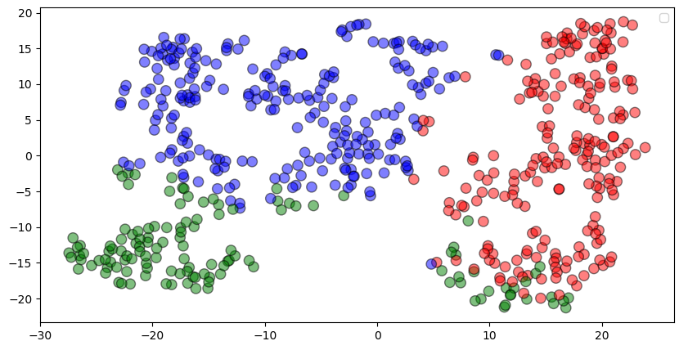
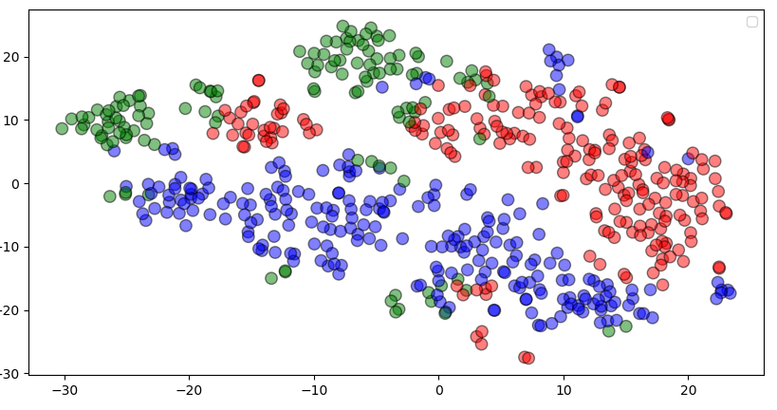
What do the Clusters Look Like
TSNE on FA components
TSNE on Raw Mean Features
Dimension 2
Dimension 2
Dimension 1
Dimension 1
Cluster 0
Cluster 1
Cluster 2

Slide 60
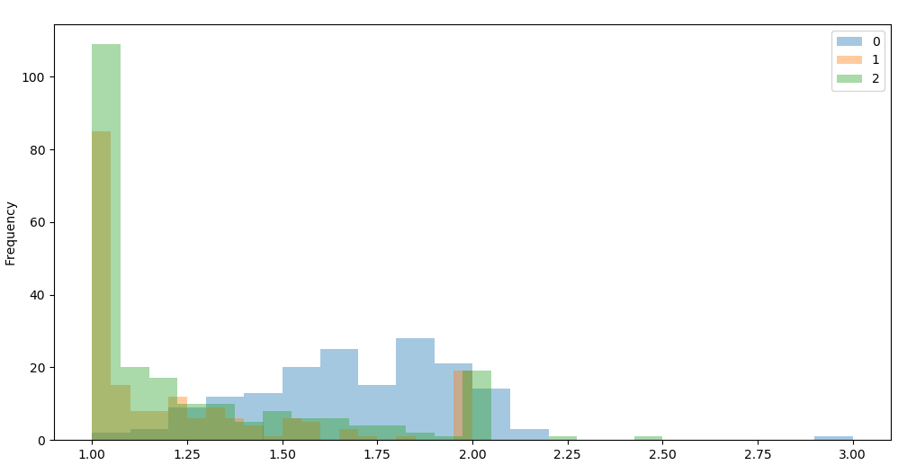
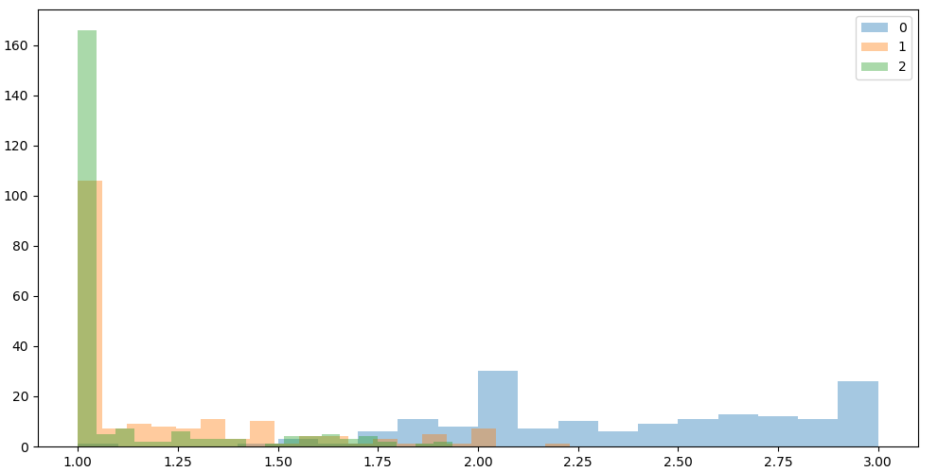
Risk Profile Feature Distributions: Cluster 0
Mean Spend
Mean ABC
Risk Level bins
Risk Level bins
Cluster 0
Cluster 1
Cluster 2

Slide 61
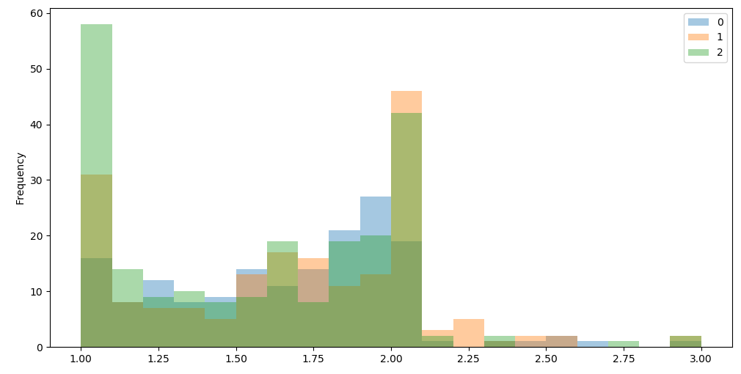
Risk Profile Feature Distributions: Cluster 1
Mean Quantity
Cluster 0
Cluster 1
Cluster 2
Risk Level bins

Slide 62
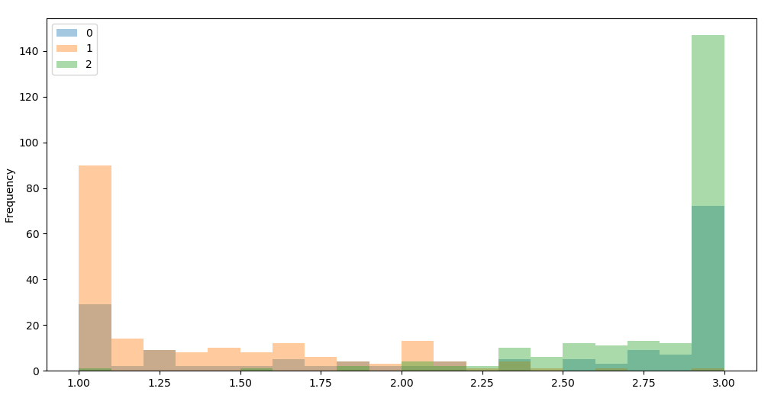

Risk Profile Feature Distributions: Cluster 2
Mean Source
Mean Unexpected Cost
Risk Level bins
Risk Level bins
Cluster 0
Cluster 1
Cluster 2

Slide 63

Risk Sum Analysis
Cluster | Risk Level | Contributing Features
Cluster 0 | High | Spend
 |  | ABC
Cluster 1 | Low | Quantity
Cluster 2 | Medium | Source
 |  | Unexpected Cost
Frequency
High Risk
Medium Risk
Low Risk
0
1
2
Cluster

Slide 64
Future Work
Clustering
Data
Risk Sum Calculation

Slide 65
Clustering
Apply Gaussian/Beta Mixture Model Clustering
Other Clustering Models
Test Set for Predicting Risk Profile for Suppliers

Slide 66
Data
Make data pipeline more conducive to these methods
Internal info about scorecard calculation

Slide 67
Risk Sum Calculation
Weight Risk Sum
Survey Harris employees as input to weights
Or give them different sets of weights -> results and have them assess

Slide 68
THANK YOU
Questions ?

